Slide 1
Lisa Backman – President lbackmannasp@gmail.com
Kathy Gillis – Chair GPR Committee – kgillis@rsu14.org
Mary MacLennan – NASP Delegate – memaclennan@gmail.com
Ruth Crowell – Past President – rcrowellmasp@gmail.com
Website – www.masponline.net

Slide 2
What is the Maine Association of School Psychologists?
The Professional Organization representing Maine School Psychologists
Maine Affiliate with the National Association of School Psychologists
Provides Professional Training, Resources & Support to our Members and Other Educational Professionals
Advocates for Children, Families and Schools in Maine
Collaborates with Maine’s DOE and MADSEC

Slide 3
Who Are School Psychologists?
School Based Professionals with Expertise in
Learning Behavior Mental Health School Systems

Slide 4
School Psychologists Training
The only professionals with advanced training in both Psychology and Education
Trained in using data to guide decision making across educational settings
Certified through the Department of Education (093)
Some also licensed as Psychologists or Psychological Examiners

Slide 5
How to become a School Psychologist
Training standards set by the
National Association of School Psychologists (NASP)
Requires Specialist Level Training
60 graduate semester hours
USM Masters in Education requires 30 – 36 hours
Masters Degree in Psychology requires 30 – 40
A series of practicum experiences
A full year (1,200 hours) of supervised internship
At least 600 of which must be in a school setting
Pass the National Praxis School Psychologist Exam
Become certified through the DOE

Slide 6
What is the role of a School Psychologist?

Slide 7
School Psychologists Provide
Academic, Behavioral & Mental Health Interventions and Supports
.Evaluation, Assessment and Data Analysis
Consultation with Teachers, Support Staff, Families and Administrators
Culturally Responsive Services
Support with School Climate, School Safety and Crisis Prevention & Response
Liaison with Outside Agencies and Professionals

Slide 8
School Psychologist Service Delivery
Direct Individual Services
Academic, Behavioral & Psychological Assessment
Develop Academic, Behavioral & Mental Health Interventions
Provide Individual and Group Counseling & Instruction

Slide 9
Classroom Based Services
Gather Student and Classroom-based Data
Observations, Interviews, Evaluations & Data-Analysis
Consult with teacher in Developing
Academic Interventions, Behavior Plans, Classroom Management Strategies

Slide 10
School-Wide Services
Collect and Analyze School-wide Data – provide consultation in applying this data in identifying areas of need and offering recommendations
Training & Leadership on RTI/MTSS Teams for Academics and Social/Emotional Learning (SEL)
Consult in Developing Academic, Social, Emotional and Behavioral Curriculum, Policies and Procedures
Provide consultation on school-wide safety plans including protocols for Threat Assessment, Risk Assessment, Safety Drills, Crisis Response, etc.
Collaborate with community mental health service agencies
Provide Staff Training

Slide 11
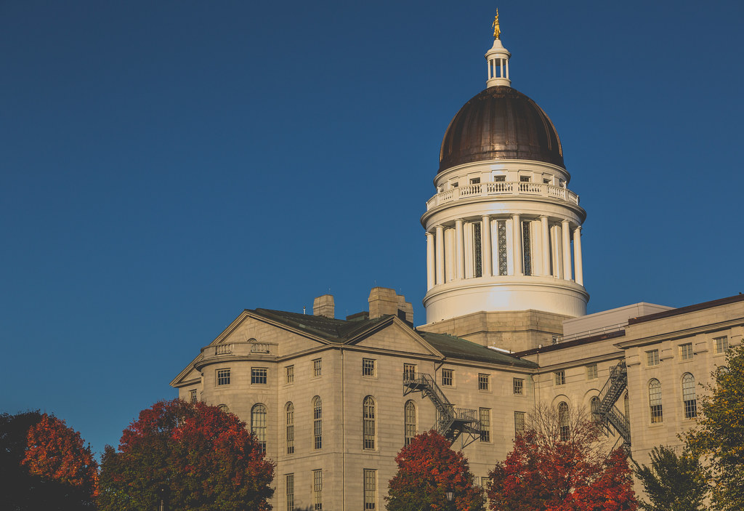
2023 MASP Legislative and Policy Priorities

Slide 12
#1 Goal Address the Shortage of School Psychologists in Maine
Last school year 9.9 School Psychologist positions remained unfilled
The lack of school psychologists results in schools not receiving adequate services to meet federal and state special education requirements and to provide much needed services to schools, especially rural schools
The Recommended Ratio of School Psychologists to Students is: 1 – 500/700
Maine’s current ratio: 1 – 1625
This year 16.9 Positions remain unfilled

Slide 13
Strategies for Addressing School Psychologist Shortage
Continue to support USM’s School Psychologist training program
Set a statewide goal for a 1 - 500 Ratio of School Psychologists
Provide contracts consistent with the training and role of school psychologists rather than placing them on teacher contracts
Pay rate consistent with specialist & doctoral levels of training
NCSP stipend consistent with NBC stipend
Loan forgiveness access similar to teacher access
Support reimbursement for School Psychologist’s services through MaineCare

Slide 14
Streamline Certification Process
093 Certification Process Improved in 2022 as part of recent update to Educational Certifications – MASP consulted with DOE to upgrade specific criteria for School Psychologists
LD 67 - An Act to Increase the Number of Educational Professionals by Accepting Out-of-State Certification
Beneficial concept, details would need to be addressed to ensure continuing appropriate standards in this specialized field and to coordinate with Maine specific requirements
NASP is in the process of developing interstate compact regulations in conjunction with federal agencies and the Council of State Governments
HP 631 passed and signed in 2021 for Maine to join Psychology Interstate Compact

Slide 15
Goal #2: Develop Effective School-Wide MTSS Programming
Multi-Tiered Systems of Support (MTSS) are proven to increase academic progress as well as improving student behavior
The Majority of Maine Schools have not implemented Comprehensive MTSS Programming
Set statewide Goals for the development of effective MTSS Academic and Social/Emotional Learning (SEL) programming
Increase MTSS Training and Resources to Districts
Evaluate District Progress towards these Goals
Consider adopting the Boston model for addressing behavioral/mental health MTSS https://cbhmboston.com/

Slide 16
Goal #3. Promote Effective Non-Exclusionary Positive School Discipline Policies and Procedures
Exclusionary and Punitive Discipline is ineffective in improving student behavior and often has negative outcomes for Students, Schools and Communities.
Exclusionary and Punitive procedures are applied Disproportionately to Minority Populations including Special Education Students
Non-Exclusionary Positive Policies and Procedures are shown to be More Effective in Improving School Safety, School Climate and Student Success
Exclusionary Discipline is associated with reduction in life-long earnings, increased health care and social welfare needs and increased chances of being involved in the criminal justice system.

Slide 17
Recommendations for Improving School Discipline Policies and Procedures
Gather Data on the use of Punitive and Exclusionary Discipline Procedures in Maine Schools
Provide Goals for Districts in Developing Non-Exclusionary Positive School Discipline Policies and Procedures
Provide Resources and Training in Effective School Discipline – this ties in with SEL MTSS
Evaluate District Progress towards Implementation of Effective School Discipline Procedures

Slide 18
We would be happy to offer our services in support of legislation to improve Maine Schools.
Feel free to contact:
Lisa Backman – President lbackmannasp@gmail.com
Kathy Gillis – Chair GPR Committee – kgillis@rsu14.org
Mary MacLennan – NASP Delegate – memaclennan@gmail.com
Ruth Crowell – Past President – rcrowellmasp@gmail.com

Slide 19
References
Who Are School Psychologists?
file:///C:/Users/rhcro/Downloads/Who%20Are%20School%20Psychologists%20In
file:///C:/Users/rhcro/Downloads/who_are_school_psychologists_flyer.pdf
Positive Non-Exclusionary Discipline
file:///C:/Users/rhcro/Downloads/Discipline-Framework-Document%20(1).pdf
Multi-Tiered Systems of Supports
file:///C:/Users/rhcro/Downloads/ESSA%20MTSS%20Decision-Makers%20(1).pdf
School Psychology Shortages
file:///C:/Users/rhcro/Downloads/2-22%20Final%20Key%20Messages%20-%20Shortages.pdf

